Slide 1

Intro to Flip-Flops

Slide 2
Flip-Flops
"Flip-flop" is the common name given to two-state devices which offer basic memory for sequential logic operations. Flip-flops are heavily used for digital data storage and transfer and are commonly used in banks called "registers" for the storage of binary numerical data.
*Note: Sequential logic means order matters and prior history does too as opposed to combinational logic where order doesn’t matter (what we’ve been doing up to now.)

Slide 3
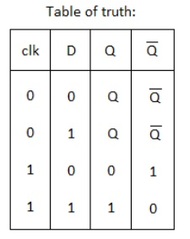
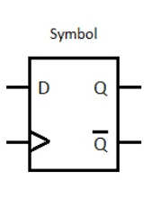
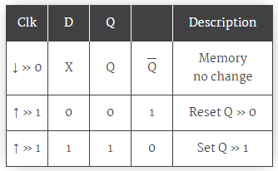
D flip-flop
The D flip-flop tracks the input, making transitions with match those of the input D. The D stands for "data"; this flip-flop stores the value that is on the data line. It can be thought of as a basic memory cell.

Slide 4

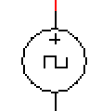

Clock Signal (moving truth table)

Slide 5
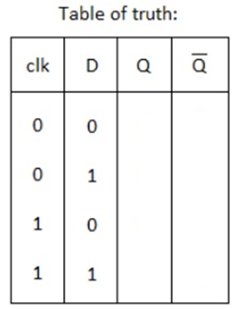
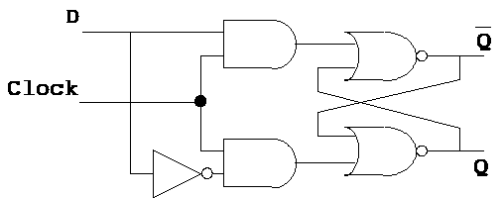
D flip-flop in gate form

Slide 6
Open DflipflopBreakdown

Slide 7
Shift Registers
Shift registers produce a discrete delay of a digital signal or waveform. A waveform synchronized to a clock, a repeating square wave, is delayed by “n” discrete clock times, where “n” is the number of shift register stages. Thus, a four stage shift register delays “data in” by four clocks to “data out”.

Slide 8
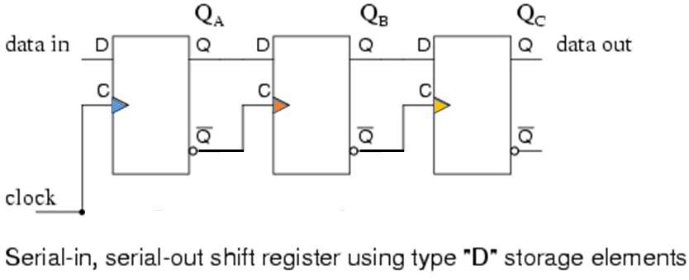
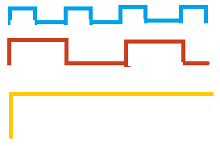
Shift Registers
← Does this remind you of anything?

Slide 9
Auto BCD to 7-Seg Display
Build a shift register out of D flip-flops to automatically create the binary numbers 0-9. Each stage of the shift register (each flip-flop) will create one input.
The !Q of the previous D flip-flop should connect to the next clock (as in the pervious slide) and it should also feed back to the original D input (on the current flip-flop).
Attach this shift register circuit to your original BCD to 7-Seg display circuit so that the end result is a display that changes digits automatically on each clock cycle.
Write an explanation for this new part of your circuit. Explain how the D flip-flops work, how they come together to make a shirt register, and how they produce the digits from 0 – 9. It might be helpful to include a truth table or some other diagram to illustrate your explanation. (Submit your explanation on the HUB.)

